Slide 1
Regular vs Online Education
By - Basit Budroo
Charan Raju
Shweta Rawat
Shweta Rathod
Lakhvinder Singh

Slide 2
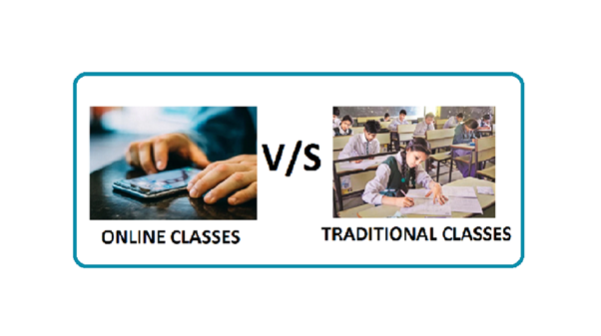
Topic Outline
Introduction
Regular Education
Online Education
Pros of Regular Education
Cons of Regular Education
Pros of Online Education
Cons of Online Education
Conclusion

Slide 3

Introduction
As the world has advanced towards technology, we live in an era where information can be acquired from any part of the world. From any place, any time and from anybody.The newest advancement in technology is the one where education is being transmitted in the form of bits and bytes across the world. A student who can only dream of being a part of a university located in the other part of the world can now stay at home and study the course that the college to offer.

Slide 4
Regular Education
Types:
Traditional
Progressive
Traditional Education
Back-to-basics, conventional, customary
Impart skills & standards of moral conduct to next generation necessary for material and social success.
Traditional teacher-centered methods focused on rote learning and memorization

Slide 5
Progressive Education
Began in late 19th Century
Emphasis on learning by doing.
Group work and development of social skills
Strong emphasis on problem solving and critical thinking.
Collaborative and cooperative learning projects
De-emphasis on textbooks in favor of varied learning resources
John Locke and Jean-Jacques Rousseau were forerunners of this idea.

Slide 6
Online Education
Online education is internet supported learning
Online graduations, courses popular nowadays
Self paced learning
Education more accessible than ever before

Slide 7
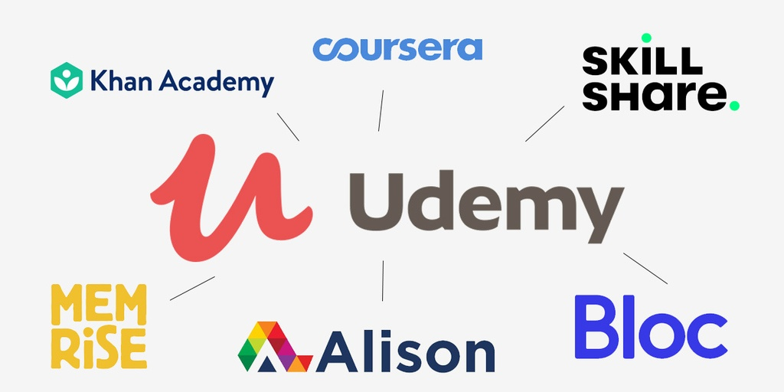

Slide 8
Pros of Regular Education
Individualised monitoring
Structured & disciplined setting
Face to face interactions
Competitive atmosphere
Interaction with peers
Extra-curricular activities

Slide 9
Cons of Regular Education
The education is mostly costly as schools have became large, and number of books are needed. (Costly education)
Few students, who are very weak at studying, are harsh-treated and are not always understood.
The rules of modern schools sometimes put students into despair and tension.
Students need to carry heavy bags, which put stress on their body.
There can be geographical and/or time barriers.
Mobility of education is absent.

Slide 10
Pros of Online Education
1. Efficiency: Online learning offers teachers an efficient way to deliver lessons to students. Online learning has a number of tools such as videos, PDFs, podcasts, and teachers can use all these tools as part of their lesson plans.
2. Accessibility Of Time And Place: Another advantage of online education is that it allows students to attend classes from any location of their choice
3. Affordability: Another advantage of online learning is reduced financial costs. Online education is far more affordable as compared to physical learning. This is because online learning eliminates the cost points of student transportation, student meals, and most importantly, real estate. Additionally, all the course or study materials are available online, thus creating a paperless learning environment which is more affordable.
4. Improved Student Attendance: Since online classes can be taken from home or location of choice, there are fewer chances of students missing out on lessons.

Slide 11
Cons of Online Education
Ease of cheating.
Children with less resources lack proper education.
Equipment is mostly costly.
Discipline is absent.
There is a lack of social interaction between instructor and student.
Asynchronous communication hinders fast exchange of information and/or questions between instructor and student.

Slide 12
Conclusion
Hence, the two systems of education has got benefits and drawbacks it cannot be told this particular system is best or worst. According to our convenience and based on the suitability of the benefits you can choose the best one and educate yourself well. Somebody has said the truth – “Nothing is Perfect!”

Slide 13
Thank You

